Slide 1
Application Catalog Tool - Version 1

Slide 2
Agenda
Visual Studio Project Structure
Solution Structure
Code Catalog

Slide 3
Visual Studio Project Structure
1 Visual Studio Solution File has many Projects.
1 Visual Studio Project has many Files.
1 Project is dependent on 1 or many Projects.
1 File is dependent on 1 or many Projects.
1 File is made up of 1 or many lines.
1 Line is made up of 1 or many words.
A project compiles into an Assembly.
An assembly consists of 1 or many classes (files).
A Class consists of 1 or many functions.

Slide 4
Solution Structure
Word 1
Line 1
File 1
Word n
Line n
Project 1
File n
Solution
Function 1
Class 1
Function n
Project n
Class n

Slide 5
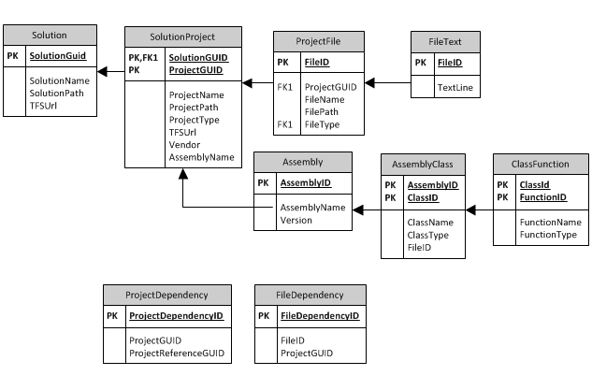
Application Catalog

Slide 6
Analysis Reports
How big is our code base?
How many different file types are we using?
How many projects does RealEC have?
What are the different project types we have?
How many different Vendor assemblies are there?
What are the dependencies between applications?
What are the dependencies between projects?
What are file dependencies?
The result of this analysis:
Allow better coordination between developers.
Faster and less error prone deployments.
Better understanding of our code base.
Ability to re-architecture and fix defects.

Slide 7
Available Commands
catalog list-solutions
Lists all solutions in TFS
catalog list-filetypes
Recursively traverse apps and list all file types.
catalog simple houengtfs01
Takes 2 minutes to run against houengtfs01.
Catalogs applications, solutions, projects etc.
catalog advance houengtfs01
Takes 9 minutes to run.
Performs additional steps of generating file dependency.
Generate unique key words dictionary.
catalog search *.cs “pattern”
Search all file text using patterns and file types.
catalog report ProjectName.prj
Generate dependency report for specified project.

